Slide 1

LINEAR CONTROL
SYSTEMS
Ali Karimpour
Assistant Professor
Ferdowsi University of Mashhad
Notes:
<<<1.1>>>
###Control System Design###
{{{Control, Design}}}

Slide 2
Lecture 25
Nyquist stability criteria (Continue).
Topics to be covered include:
Nyquist stability criteria (continue).
Minimum phase systems.
Simplified Nyquist stability criterion.

Slide 3

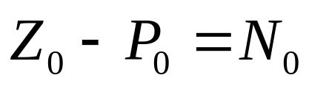
Nyquist fundamental
Nyquist path
Nyquist plot

Slide 4
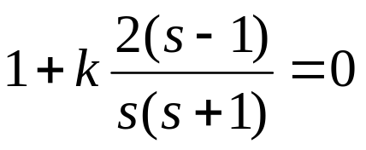
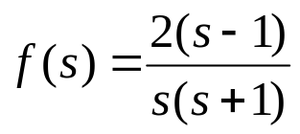
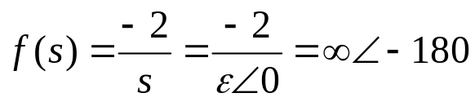
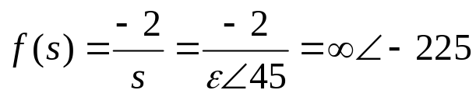
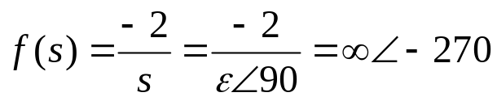
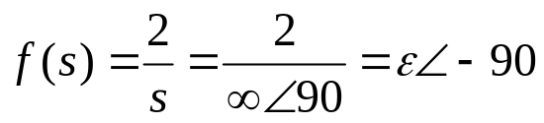
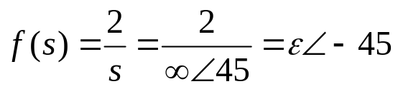
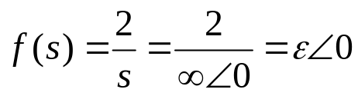
Example 1: Discuss about the RHP roots of following system.
مثال 1: در مورد ریشه های سمت راست معادله روبرو بر حسب مقادیر مختلف k بحث کنید.
?
Very important part

Slide 5
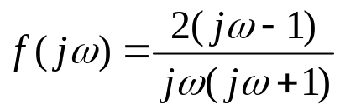







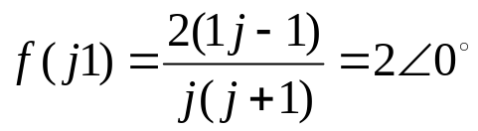


Example 1: Discuss about the RHP roots of the following system.
مثال 1: در مورد ریشه های سمت راست معادله روبرو بر حسب مقادیر مختلف k بحث کنید.
?
?
Which point is very important?

Slide 6






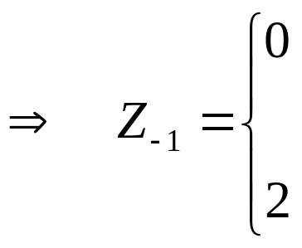




Example 1: Discuss about the RHP roots of the following system for different values of k.
مثال 1: در مورد ریشه های سمت راست معادله روبرو بر حسب مقادیر مختلف k بحث کنید.
Unstable( one RHP root)
Stable
Unstable
(two RHP root)
More Study:

Slide 7

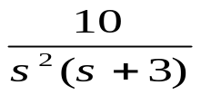
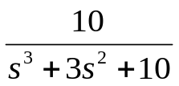
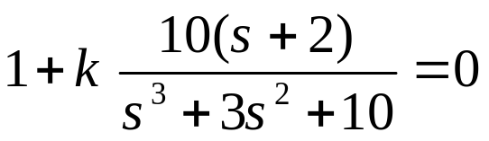
Example 2: Discuss about the stability of the following system for different values of k.
مثال 2: پایداری سیستم را بر حسب مقادیر مختلف k بحث کنید.
+
+
-
-
+
-
فرم استانداردمعادله به صورت زیر است:

Slide 8
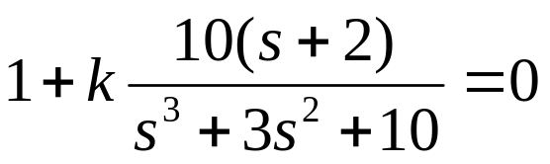
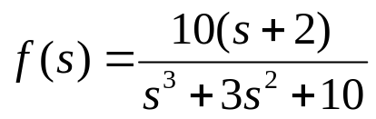
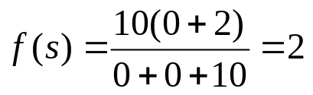
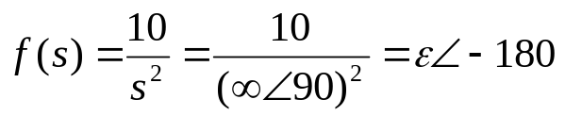
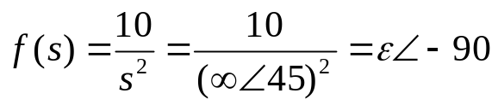

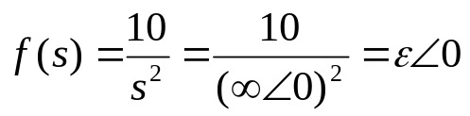
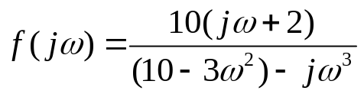
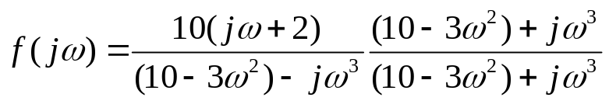
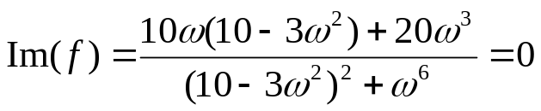

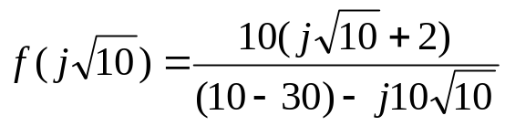
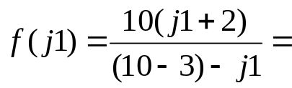
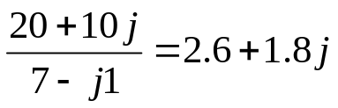

Discuss about the RHP roots of:
How?

Slide 9







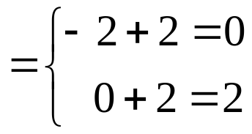







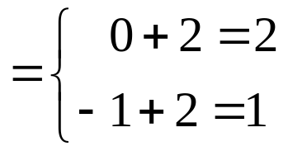


Discuss about the RHP roots of:
Stable
Unstable
2 RHP roots
Unstable (2 RHP roots)
Unstable (1 RHP roots)

Slide 10
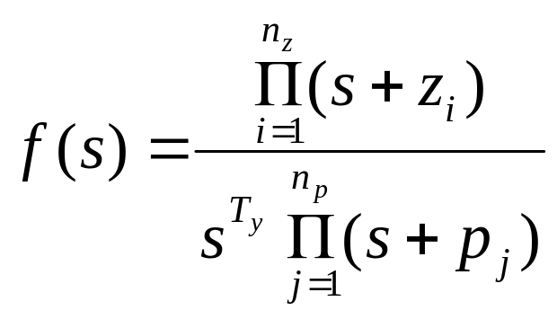
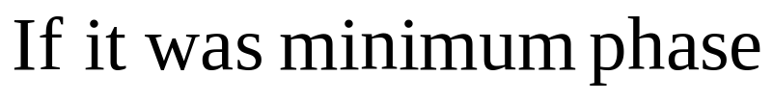
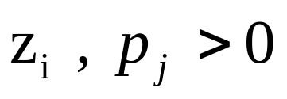
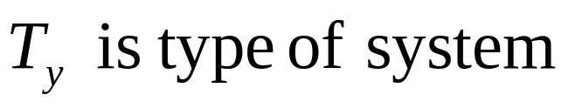


Minimum Phase systems
توابع حداقل فاز
f(s) is said to be minimum phase if it has no poles and zeros on the RHP and on the jω axis (origin is an exception) and there is no delay.
تابع f(s) را حداقل فاز گویند اگر این تابع هیچ قطب و صفری در RHP و روی محور jω نداشته (مبدا استثنا است) و دارای تاخیر نباشد.
Important note:

Slide 11
Nyquist fundamental for minimum phase systems
Nyquist path
Nyquist plot

Slide 12

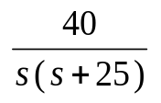


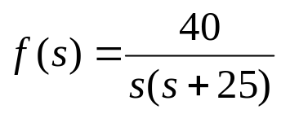
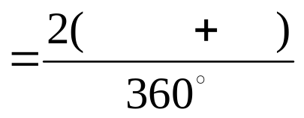
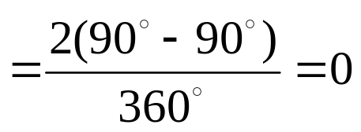



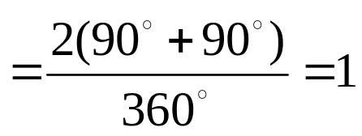




+
Check the stability of following system by Nyquist method.
-
-1
System is minimum phase
90T_{y}
φ₋₁
90T_{y}
φ₁

Slide 13
+
Check the stability of following system by Nyquist method.
-
Simplified Nyquist
path plot
-1
polar plot
System is minimum phase
90T_{y}
φ₋₁
φ₋₁ is the angle of polar plot around -1
90T_{y}
φ₁
φ₁ is the angle of polar plot around 1

Slide 14
Simplified Nyquist method
-1
System is minimum phase
Simplified Nyquist
path plot
Polar plot
90T_{y}
φ₋₁
φ₋₁ is the angle of polar plot around -1
90T_{y}
φ₁
φ₁ is the angle of polar plot around 1

Slide 15
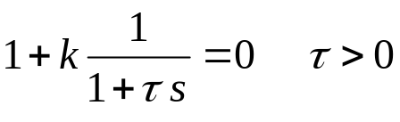
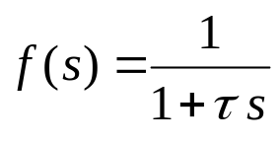
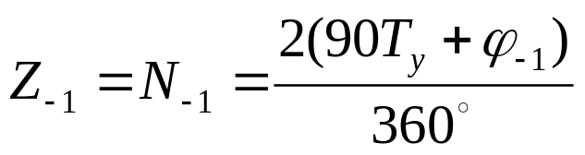
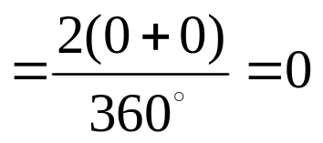

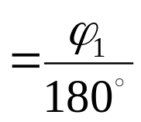
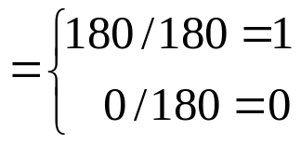
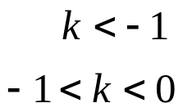
Example 3: Discuss about the RHP roots of the following system for different values of k.
مثال 3: در مورد ریشه های RHP سیستم زیر بر حسب مقادیر مختلف k بحث کنید.
Clearly System is minimum phase so we use simplified Nyquist method
-1
1
Simplified Nyquist
path plot
Polar plot
No RHP root.
One RHP root.
No RHP root.

Slide 16
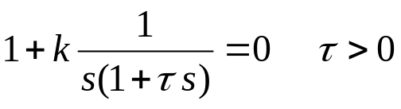
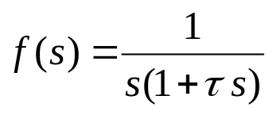
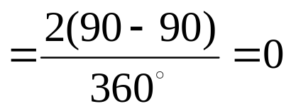
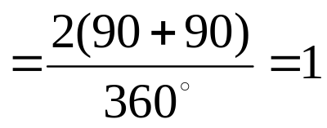
Example 4: Discuss about the RHP roots of the following system for different values of k.
مثال 4: در مورد ریشه های RHP سیستم زیر بر حسب مقادیر مختلف k بحث کنید.
Clearly System is minimum phase so we use simplified Nyquist method
-1
1
Simplified Nyquist
path plot
Polar plot
No RHP root.
One RHP root.

Slide 17
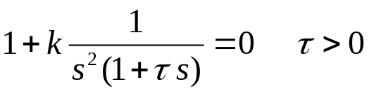



Example 5: Discuss about the RHP roots of the following system for different values of k.
مثال 5: در مورد ریشه های RHP سیستم زیر بر حسب مقادیر مختلف k بحث کنید.
Clearly System is minimum phase so we use simplified Nyquist method
-1
1
Simplified Nyquist
path plot
Polar plot
Two RHP roots.
One RHP root.

Slide 18




Example 6: Discuss about the RHP roots of following system for different value of k.
مثال 6: در مورد ریشه های RHP سیستم زیر بر حسب مقادیر مختلف k بحث کنید.
Clearly System is minimum phase so we use simplified Nyquist method
-1
1
Simplified Nyquist
path plot
Polar plot
Two RHP roots.
One RHP root.

Slide 19
Simplified Nyquist method
-1
Simplified Nyquist
path plot
System is minimum phase
Polar plot
90T_{y}
φ₋₁
φ₋₁ is the angle of polar plot around -1
90T_{y}
φ₁
φ₁ is the angle of polar plot around 1
Important remark: If any of φ₋₁ or φ₁ is greater than zero the system is unstable but if they were less than zero one must check it!

Slide 20
Simplified Nyquist method
-1
Unstable
Polar plot
Simplified Nyquist
path plot
-1
Polar plot
Stability depends on T_{y}

Slide 21


Exercises
تمرینها
1- The open loop transfer function of a unity-feedback (negative sign) is:
Apply the Nyquist criterion to determine the range of k for stability. Let n=1,2,3 and 4
2- The characteristic equation of a linear control system is:
Apply the Nyquist criterion to determine the range of k for stability.

Slide 22

Exercises
تمرینها
3- The open loop transfer function of a unity-feedback (negative sign) with PD controller is:
Select the value of K_{p} so that the parabolic error constant be 100. Find the equivalent open-loop transfer function G_{eq}(s) for stability analysis with K_{d} as a gain factor. Sketch the Nyquist plot and check the stability for different values of K_{d}.

